Slide 1
general
Fp32 480*1K
Sclk = 1087 MHz
M=480, N=1024, K=1024
Pad = 32(32 DW)
Performance = 18.078 Tflops
Efficiency = 54.14%
Macro tile = 32*128
depthU = 32(32 DW)
Mfma = 32*32*2
Fp16 480*1K
Sclk = 1087 MHz
M=480, N=1024, K=1024
Pad = 32(16 DW)
Performance = 39.321Tflops
Efficiency = 29.44%
Macro tile = 32 * 128
depthU = 64(32 DW)
Mfma = 16*16*16

Slide 2
general
sulotion
Fp32 480*1K
Iteration = 32
Fetch data = 6016 KB
Fp16 480*1K
Iteration = 16
Fetch data = 3008 KB

Slide 3
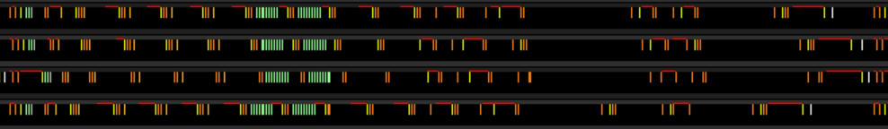
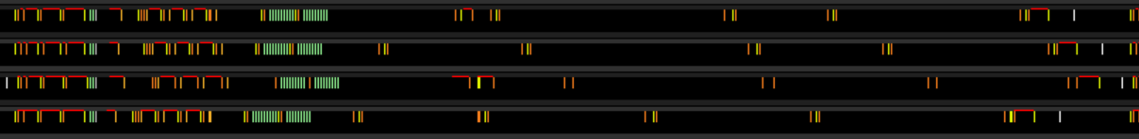
Main loop
fp32 480*1K
fetch data = 32*32*2 * 2 = 16KB
clk = 1460 clk
fetch instr. = vmem_4
fetch instr. cnt = 5
mfma instr. cnt = 16
fp16 480*1K
fetch data = 16*16*16 * 2 = 16KB
clk = 1552 clk
fetch instr. = vmem_4
fetch instr. cnt = 5
mfma instr. cnt = 16

Slide 4


Main loop
MFMA WITH VMEM
fp32 480*1K
number = 4
mfma/2 lds_rd/vmem
interval = 64 clk
fp16 480*1K
number = 4
mfma/2 lds/vmem
mfma/1 lds/vmem
interval = 32 clk
last interval:
60 clk for 2 wave
76/78 clk for 2 wave

Slide 5
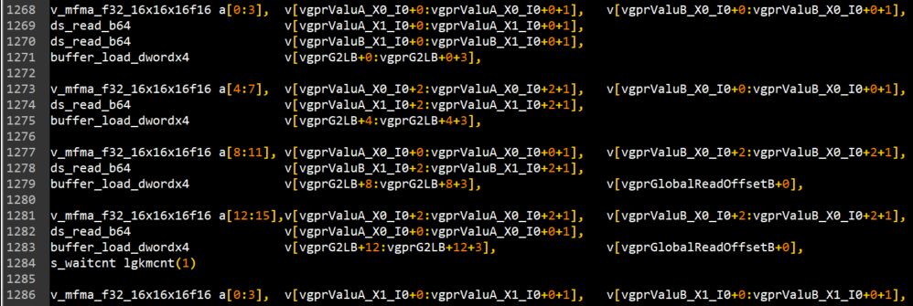
Main loop
MFMA WITH VMEM
fp16
increase s_waitcnt num to 3
but need insert more s_waitcnt instruction after

Slide 6


Main loop
MFMA with salu
fp32 480*1K
number = 2
mfma/2 lds/9 salu
interval = 64 clk
fp16 480*1K
number = 2
mfma/1 lds/9 salu
mfma/1 lds/9 salu/1 lds
first interval = 48 clk (fix)
second interval = 96 ~ 480

Slide 7
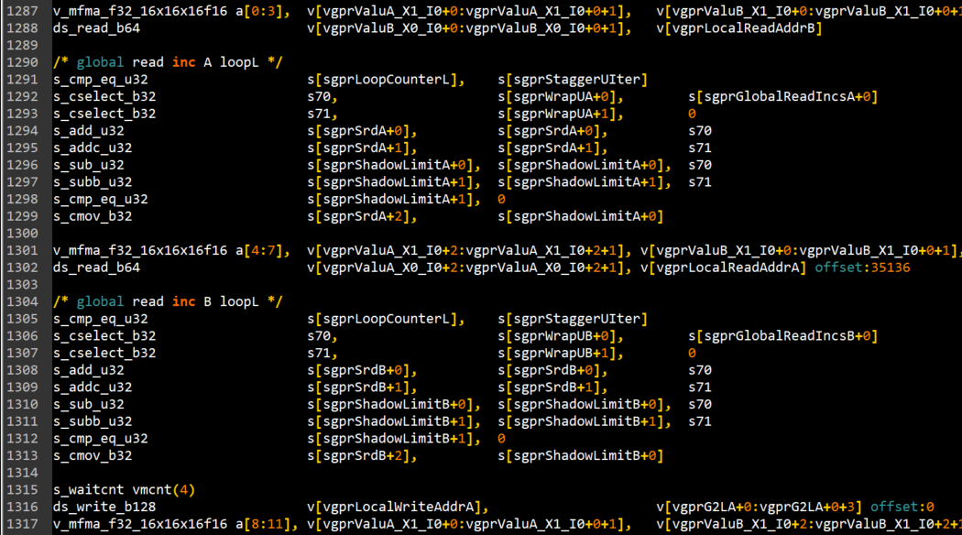
Main loop
MFMA with salu
fp16
move some of the global read inc A to the 2nd interval

Slide 8
Main loop
MFMA with lds
fp32 480*1K
number = 8
mfma/2 lds_rd (3*)
mfma/2 lds_rd/1 lds_wr (5*)
interval with lds_rd = 64 clk (fix)
interval with lds_wr = 64 ~ 340 clk

Slide 9

Main loop
MFMA with barrier
fp32
number = 1
mfma/barrier/2 lds
interval = 64 ~ 156 clk

Slide 10
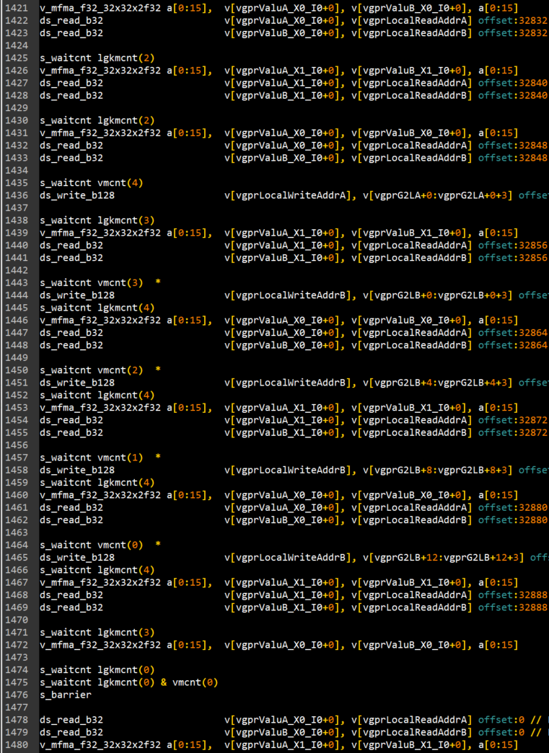
Main loop
MFMA with barrier
fp32
Blocked due to 4 vmcnt
Could delay vmcnt and ds_write for 2 interval ?

Slide 11
Main loop
MFMA with lds
fp16 480*1K
number = 5
mfma/1 lds_rd (1*)
mfma/1 lds_rd/1 lds_wr (4*)
interval with lds_rd = 32 clk (fix)
interval with lds_wr = 68 ~ 332 clk

Slide 12

Main loop
MFMA with barrier
fp16 480*1K
number = 1
mfma/barrier
interval = 48 ~ 120 clk

Slide 13
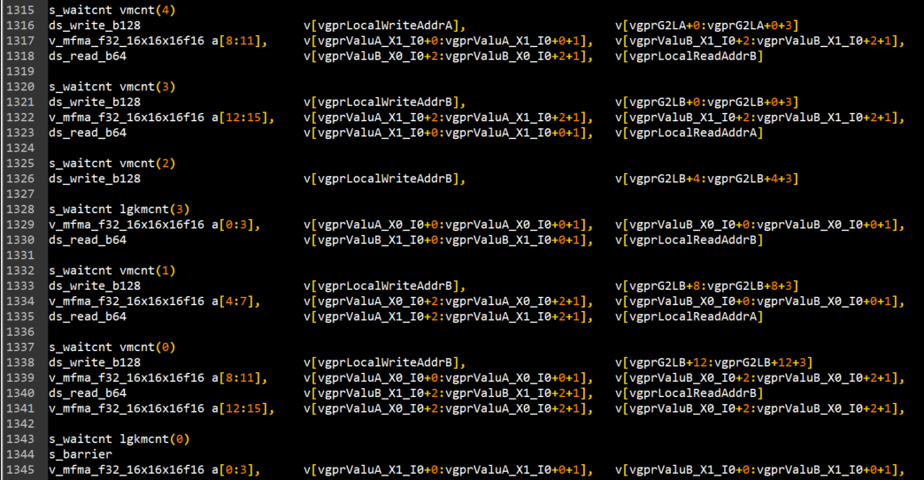
Main loop
MFMA with barrier
fp16
Increase s_waitcnt by 3

Slide 14


Main loop
MFMA with branch
fp32 480*1K
number = 1
mfma/2 salu/branch/2 lds/vmem
interval = 76 ~ 88 clk
fp16 480*1K
number = 4
mfma/2 lds (1*)
mfma/1 lds (2*)
mfma/2 salu/branch/vmem (1*)
interval with lds only = 32 clk(fix)

Slide 15
Main loop
MFMA with branch
fp32 / fp16
Bring first lds read to the end of pre-loop, before salu and branch

